Slide 1
Automatic Generation Control

Slide 2
Introduction:
Automatic Generation Control (AGC) is a crucial function in power systems that ensures the balance between the generation and demand of electrical power.
It is responsible for continuously monitoring and adjusting the power output of generators in real-time to maintain system frequency within acceptable limits.
The primary objective of AGC is to match the total generation of power to the total demand while maintaining a stable system frequency.

Slide 3
Fluctuations in power demand, unexpected generator outages, or variations in renewable energy generation can cause imbalances in the system, leading to frequency deviations.
AGC detects these imbalances and takes corrective actions by adjusting the output of generators.
This control strategy is available in two forms as:
Automatic Voltage Regulator (AVR)
Automatic Load Frequency Control (LFC)

Slide 4
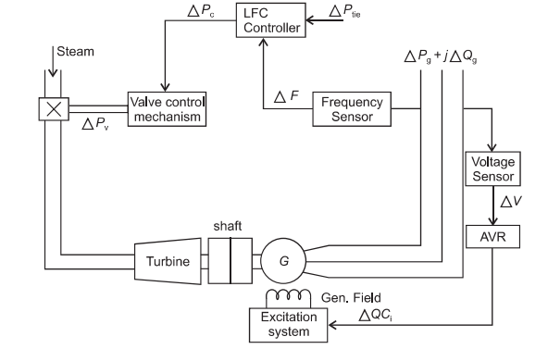
Schematic diagram of LFC and AVR of a synchronous generator.

Slide 5
Automatic Voltage Regulator (AVR)
An Automatic Voltage Regulator (AVR) is a device or control system used in power systems to regulate and maintain a consistent voltage level at the load terminals of a generator.
It adjusts the excitation level of the generator's field winding, which in turn controls the output voltage of the generator.
The primary function of an AVR is to regulate the generator's terminal voltage within an acceptable range, regardless of variations in the load demand or changes in system conditions

Slide 6
It helps to maintain the voltage stability of the power system and ensures that the connected loads receive a steady and reliable supply of electricity.
The AVR operates based on feedback control principles.
It continuously monitors the generator's output voltage using voltage sensors and compares it to a reference setpoint.
If the measured voltage deviates from the desired value, the AVR generates a control signal that adjusts the excitation current supplied to the generator's field winding.
This, in turn, modifies the magnetic field strength and regulates the generator's output voltage.

Slide 7
Load Frequency Control (LFC)
Load Frequency Control (LFC), also known as Frequency Control, is a crucial aspect of power system operation that ensures the balance between power generation and demand while maintaining system frequency within acceptable limits.
The LFC system continuously monitors the system frequency and compares it to a nominal or scheduled frequency.
Any deviation from the desired frequency represents an imbalance between generation and load. LFC uses control actions to correct this imbalance and restore system frequency to the scheduled value.

Slide 8
The primary control action in LFC is adjusting the power output of generators.
When the system frequency decreases, indicating a shortage of power, LFC sends control signals to increase the power output of generators.
Conversely, if the frequency increases due to excess generation, LFC reduces the power output to restore the balance.

Slide 9
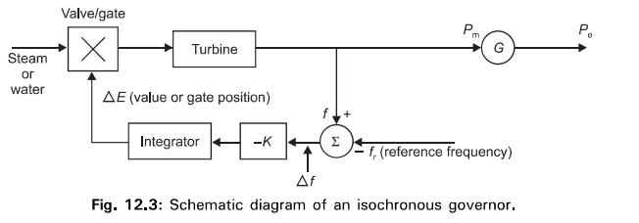
Isochronous Governor

Slide 10
Isochronous Governor:
An isochronous governor is a type of governor used in speed governing systems to maintain a constant speed of a prime mover regardless of the load or power demand.
The "isochronous" means constant speed. An isochronous governor adjusts the turbine valve/ gate to bring the frequency back to the nominal or scheduled value.
Figure shows the schematic diagram of isochronous speed governing system. The measured frequency f (or speed w) is compared with reference frequency f, (or reference speed w). The error signal (equal to frequency deviation or speed deviation) is amplified and integrated to produce a control signal ΔE which actuates the main steam supply valves in the case of a steam turbine, or gates in the case of a hydro turbine.

Slide 11
An isochronous governor works very well when a generator is supplying an isolated or when. only one generator in a multi generator system is required to respond to changes is load.
However, for load sharing between generators connected to the system, droop characteristic or speed regulator must be provided.

Slide 12
Governor with Speed-Droop Characteristics.
A governor with speed droop characteristics, also known as a droop governor, is a type of governor used in speed governing systems to regulate the rotational speed of a prime mover.
When two or more generating units are connected to the same system, isochronous governors can not be used since each generating unit would have to have precisely the same speed setting.
Otherwise, they would fight each other, each will try to control system frequency to its own setting. For stable load division between two or more units operating in parallel, the governors are provided with a characteristic so that the speed drops as the load is increased.

Slide 13
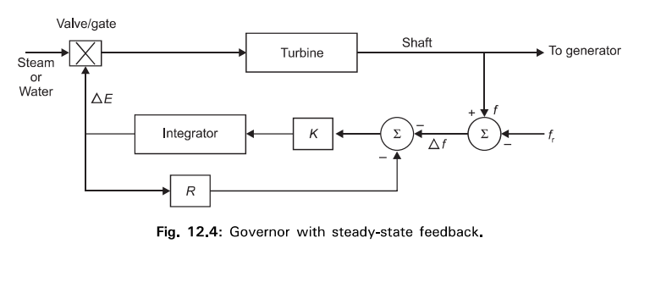
The regulation or speed-droop characteristic can be obtained by adding a steady-state feedback loop around the integrator as shown in Fig. below:

Slide 14
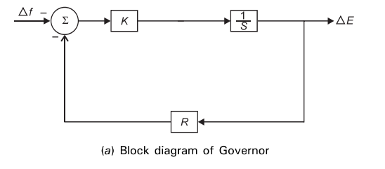
The transfer function of the governor reduces to the form as shown in fig below. This type of governor may be characterized as proportional controller with a gain 1/R.

Slide 15
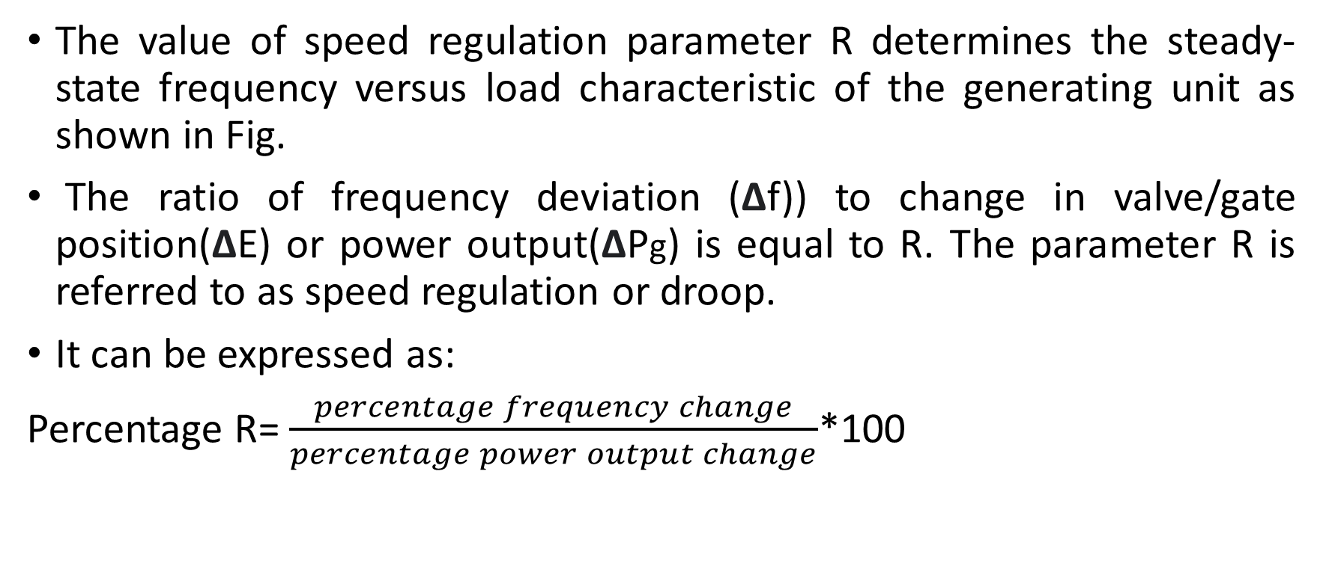
Speed regulation (DROOP)
The value of speed regulation parameter R determines the steady-state frequency versus load characteristic of the generating unit as shown in Fig.
The ratio of frequency deviation (Δf)) to change in valve/gate position(ΔE) or power output(ΔPg) is equal to R. The parameter R is referred to as speed regulation or droop.
It can be expressed as:
Percentage R= $\frac{percentage frequency change}{percentage power output change}$*100

Slide 16
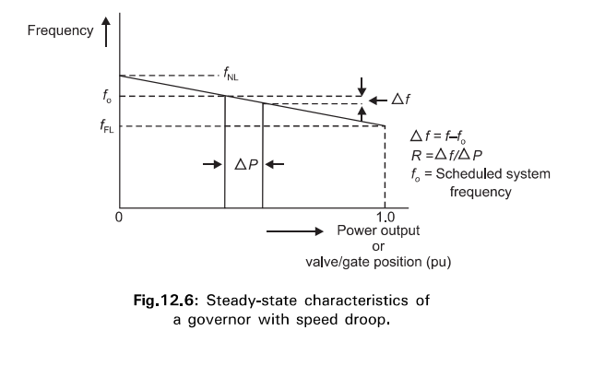
For example, a 4% droop or regulation means that a 4% frequency deviation causes 100% change in valve position or power output.

Slide 17
Load sharing by parallel generating unit.
Load sharing by parallel generating units refers to the distribution of electrical load among multiple generators operating in parallel.
When multiple generators are connected in parallel, they work together to supply power to a common electrical load.
Load sharing ensures that the load is distributed proportionally among the generators, allowing them to operate efficiently and share the workload.
If two or more generating units with drooping governor characteristics are connected to a power system, there must be a unique frequency at which they will share a load-change.

Slide 18
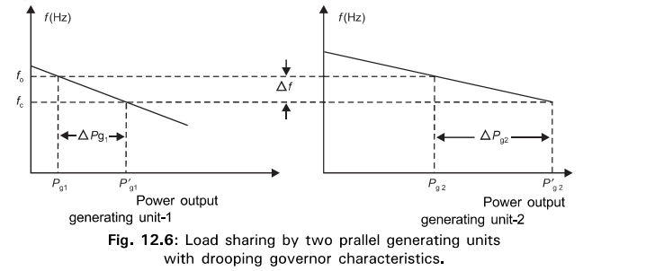
Fig. below shows the droop characteristics of two generating units.
Initially they were operating at nominal frequency f0 with outputs Pg1 and Pg2 .
An increase of load ΔPL causes the generating units to slow down and the governors increase the output until they reach a new common operating frequency fc.

Slide 19
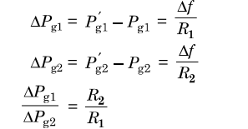
The amount of load picked up by each unit depends on droop characteristics.
If the percentage of regulation of the units are nearly equal, the change in the outputs of each generating unit will be nearly in proportional to its rating.

Slide 20
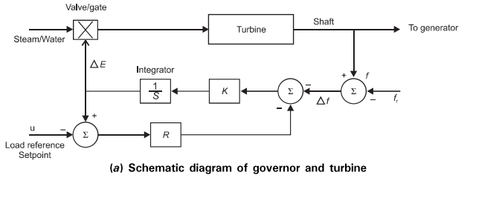
Control of power output of generating units.
The relationship between frequency and load can be adjusted by changing an input shown as “ load reference point u ” as shown in figure:

